Slide 1

Common Property and Public Goods
HE3001, Microeconomics 3 Nanyang Technological University

Slide 2
Introduction
Goods can be classified into different categories based on two different properties.
A good has the property of rivalry if the consumption by one person precludes consumption by other people.
A good has the property of excludability if individuals can be prevented from consuming the good.
 | Excludable | Non-Excludable
Rivalry | Private Good: Apple, Computer | Common Property: Park, Fishery
No Rivalry | Club Good: Concert, Cable TV | Public Good: Clean Air, National Defense

Slide 3
Introduction
In HE1001, HE2001, we have mainly focused on private goods, which are rivalrous and excludable.
Last week, externalities of private goods, can be conceptualized as involving a non-excludable good.
E.g. Cigarettes and clean air, Fishing and common sea resources…
Today, we examine economic issues involving this non-excludability:
Common property
Public goods

Slide 4
The Tragedy of Commons

Slide 5


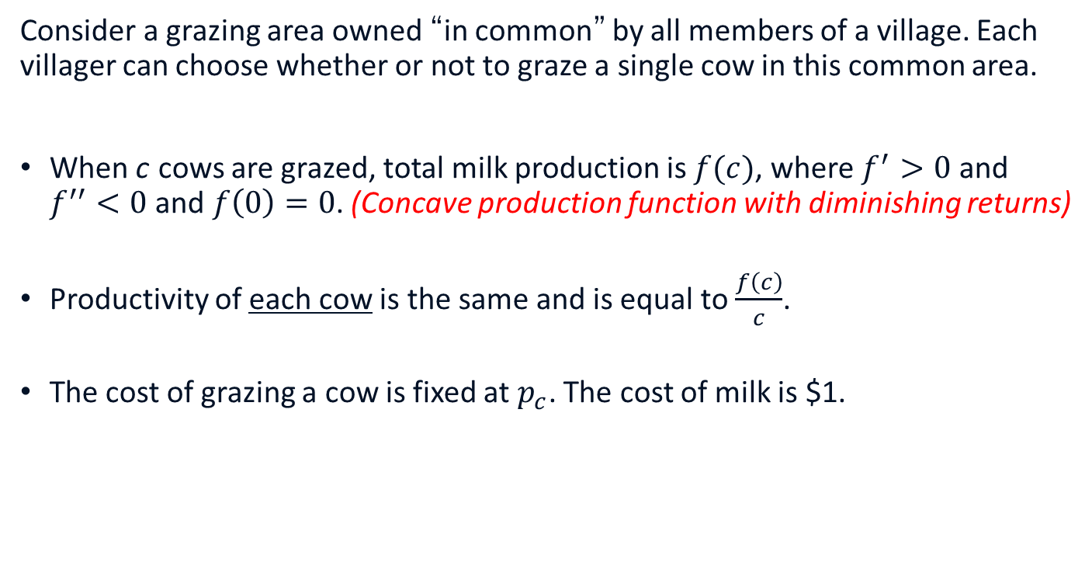
The Tragedy of Commons
Consider a grazing area owned “in common” by all members of a village. Each villager can choose whether or not to graze a single cow in this common area.
When c cows are grazed, total milk production is $f(c)$, where $f^{′}>0$ and $f^{′′}<0$ and $f\left(0\right)=0$. (Concave production function with diminishing returns)
Productivity of each cow is the same and is equal to $\frac{f\left(c\right)}{c}$.
The cost of grazing a cow is fixed at $p_{c}$. The cost of milk is $1.

Slide 6
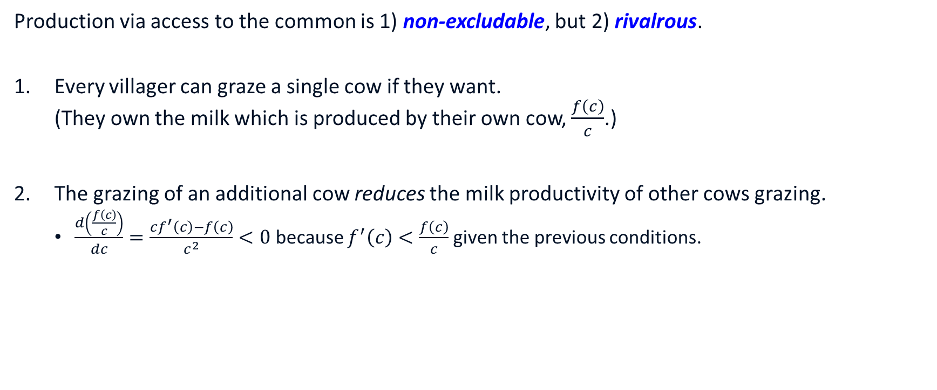
The Tragedy of Commons
Production via access to the common is 1) non-excludable, but 2) rivalrous.
Every villager can graze a single cow if they want. (They own the milk which is produced by their own cow, $\frac{f\left(c\right)}{c}$.)
The grazing of an additional cow reduces the milk productivity of other cows grazing.
$\frac{d\left(\frac{f\left(c\right)}{c}\right)}{dc}=\frac{cf^{′}\left(c\right)−f\left(c\right)}{c^{2}}<0$ because $f^{′}\left(c\right)<\frac{f\left(c\right)}{c}$ given the previous conditions.
Notes:
$f\left(c\right)=\int_{0}^{c}{f^{′}\left(x\right) dx} >\int_{0}^{c}{f^{′}\left(c\right) dx}=cf′(c)$ where the inequality comes from f’’<0

Slide 7
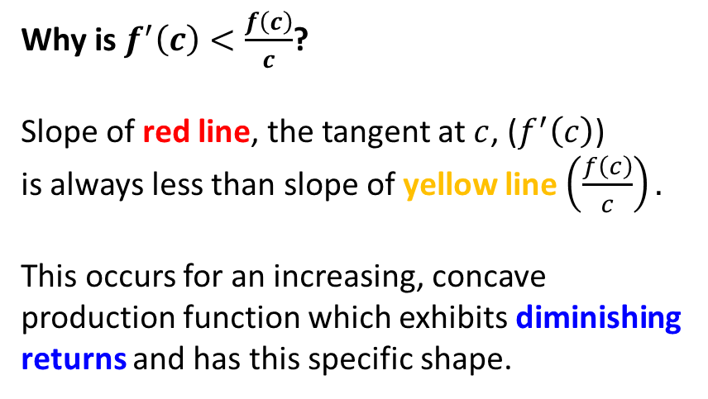


The Tragedy of Commons
Why is $f^{′}\left(c\right)<\frac{f\left(c\right)}{c}$?
Slope of red line, the tangent at $c$, ($f^{′}\left(c\right)$) is always less than slope of yellow line $\left(\frac{f\left(c\right)}{c}\right).$
This occurs for an increasing, concave production function which exhibits diminishing returns and has this specific shape.
$$f(c)$$
$$c$$

Slide 8

The Tragedy of Commons: Social Planner’s Problem
How should the village graze their cows so as to maximize their total income?
The objective is:$\max_{c≥0}{f\left(c\right)−p_{c}c}$
The solution to this problem is $c^{∗}$ where:$f^{′}\left(c^{∗}\right)=p_{c}$
This $c^{∗}$ is the socially optimal solution.

Slide 9
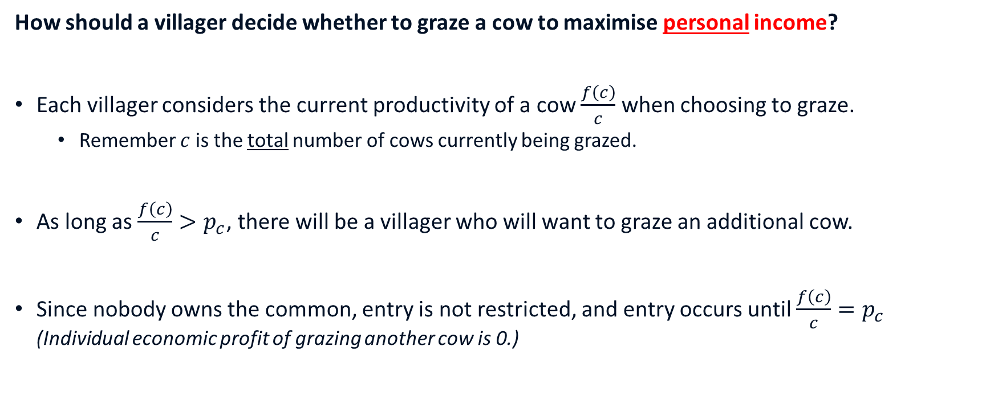
The Tragedy of Commons: Individual Problem
How should a villager decide whether to graze a cow to maximise personal income?
Each villager considers the current productivity of a cow $\frac{f\left(c\right)}{c}$ when choosing to graze.
Remember $c$ is the total number of cows currently being grazed.
As long as $\frac{f\left(c\right)}{c}>p_{c}$, there will be a villager who will want to graze an additional cow.
Since nobody owns the common, entry is not restricted, and entry occurs until $\frac{f\left(c\right)}{c}=p_{c}$ (Individual economic profit of grazing another cow is 0.)

Slide 10
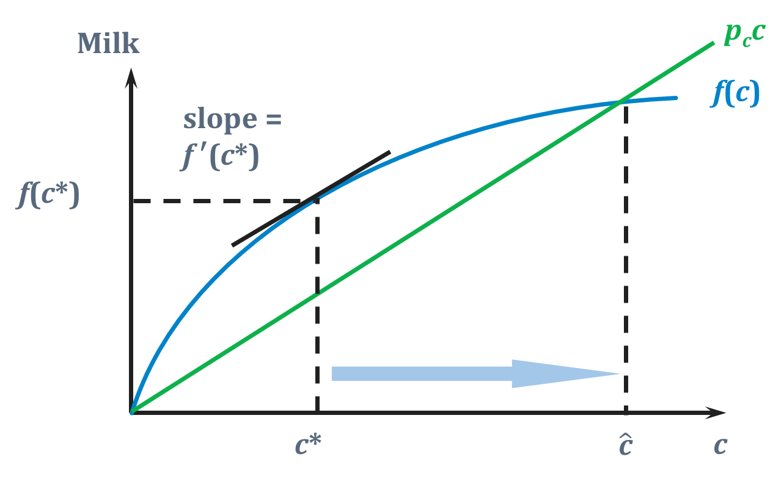
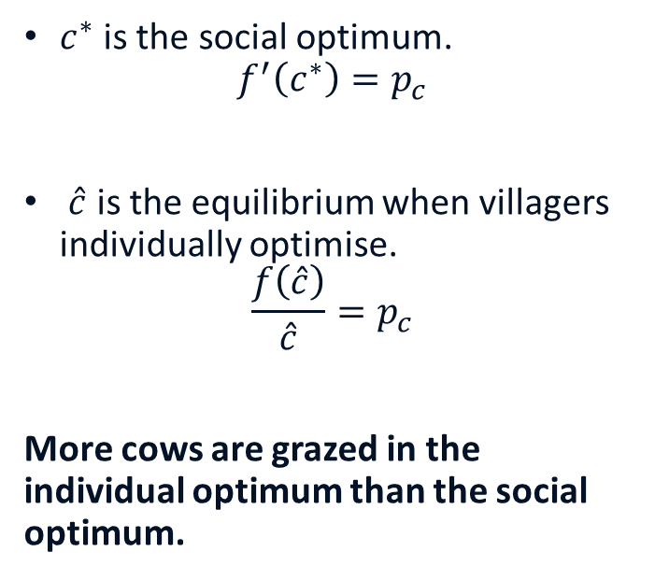
The Tragedy of Commons (Graphical Solution)
$c^{∗}$is the social optimum. $f^{′}\left(c^{∗}\right)=p_{c}$
$\hat{c}$ is the equilibrium when villagers individually optimise.
$$\frac{f\left(\hat{c}\right)}{\hat{c}}=p_{c}$$
More cows are grazed in the individual optimum than the social optimum.

Slide 11
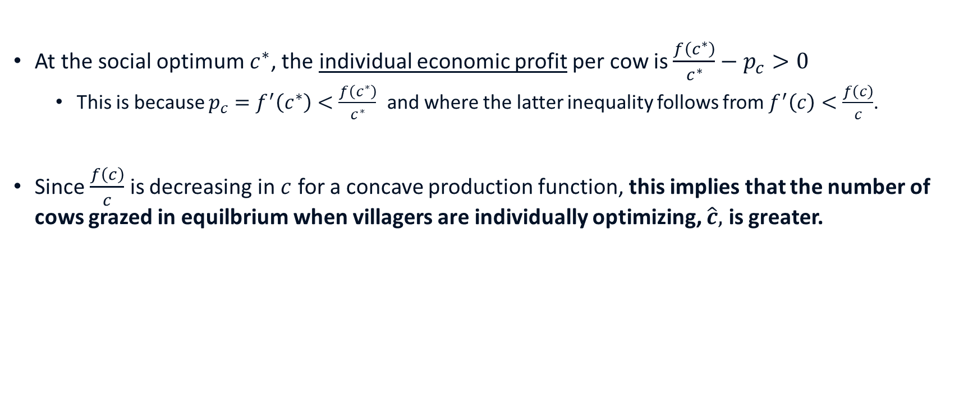
The Tragedy of Commons (Mathematically)
At the social optimum $c^{∗}$, the individual economic profit per cow is $\frac{f\left(c^{∗}\right)}{c^{∗}}−p_{c}>0$
This is because $p_{c}=f^{′}\left(c^{∗}\right)<\frac{f\left(c^{∗}\right)}{c^{∗}}$ and where the latter inequality follows from $f^{′}\left(c\right)<\frac{f\left(c\right)}{c}$.
Since $\frac{f\left(c\right)}{c}$ is decreasing in $c$ for a concave production function, this implies that the number of cows grazed in equilbrium when villagers are individually optimizing, $\hat{c},$ is greater.
Notes:
Here we ignore issues with indivisibility.
Weassume that villagers are perfectly divisible. I.e. even though cows are considered in single units. Villagers can be 1.1., 1.11 etc.

Slide 12
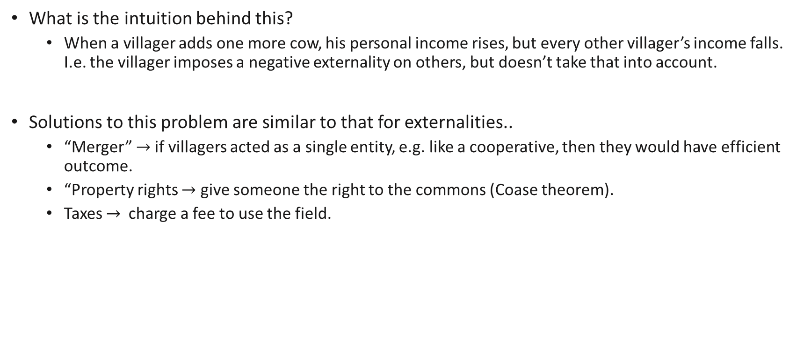
The Tragedy of Commons
What is the intuition behind this?
When a villager adds one more cow, his personal income rises$,$ but every other villager’s income falls. I.e. the villager imposes a negative externality on others, but doesn’t take that into account.
Solutions to this problem are similar to that for externalities..
“Merger” $→$if villagers acted as a single entity, e.g. like a cooperative, then they would have efficient outcome.
“Property rights $→$ give someone the right to the commons (Coase theorem).
Taxes $→$charge a fee to use the field.

Slide 13
Tragedy of Commons, Discussion
This holds in general: common property leads to a “structure” where externalities are imposed on others from private use.
Other modern-day examples:
Overfishing the high seas.
Overlogging forests on public lands.
Over-intensive use of public parks.
Urban traffic congestion

Slide 14

Review Questions 1
Suppose that there is a wi-fi access point with a capacity of 10 people. Because of bandwidth limitations, after 10 people, average wi-fi speed starts to get slower for each unit of usage. Each connected person decides how much w-ifi to use.
Suppose there are 5 people who are sharing the a wi-fi access point. Will there be a tragedy of commons (in wi-fi usage)?
Yes
No (This is the answer)
Suppose there are now 15 people who are sharing the a wi-fi access point. Will there be a tragedy of commons (in wi-fi usage)?
Yes (This is the answer)
No

Slide 15
A simple model of Public Goods

Slide 16
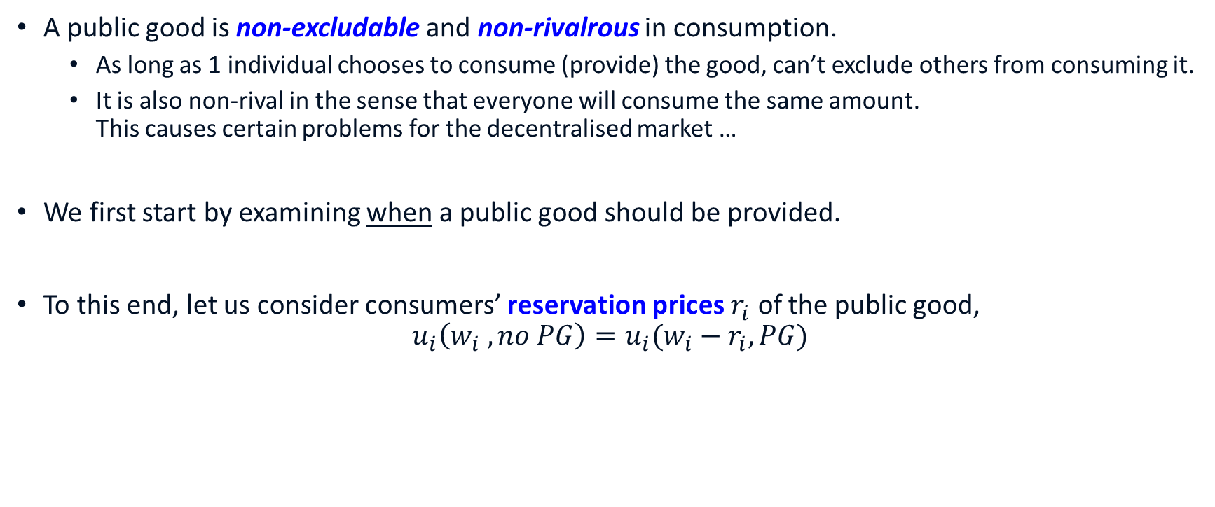
Public Goods
A public good is non-excludable and non-rivalrous in consumption.
As long as 1 individual chooses to consume (provide) the good, can’t exclude others from consuming it.
It is also non-rival in the sense that everyone will consume the same amount. This causes certain problems for the decentralised market …
We first start by examining when a public good should be provided.
To this end, let us consider consumers’ reservation prices $r_{i}$ of the public good, $u_{i}\left(w_{i} ,no PG\right)=u_{i}(w_{i}−r_{i},PG)$
Notes:
Recall that reservation prices capture the people’s valuation of goods.

Slide 17
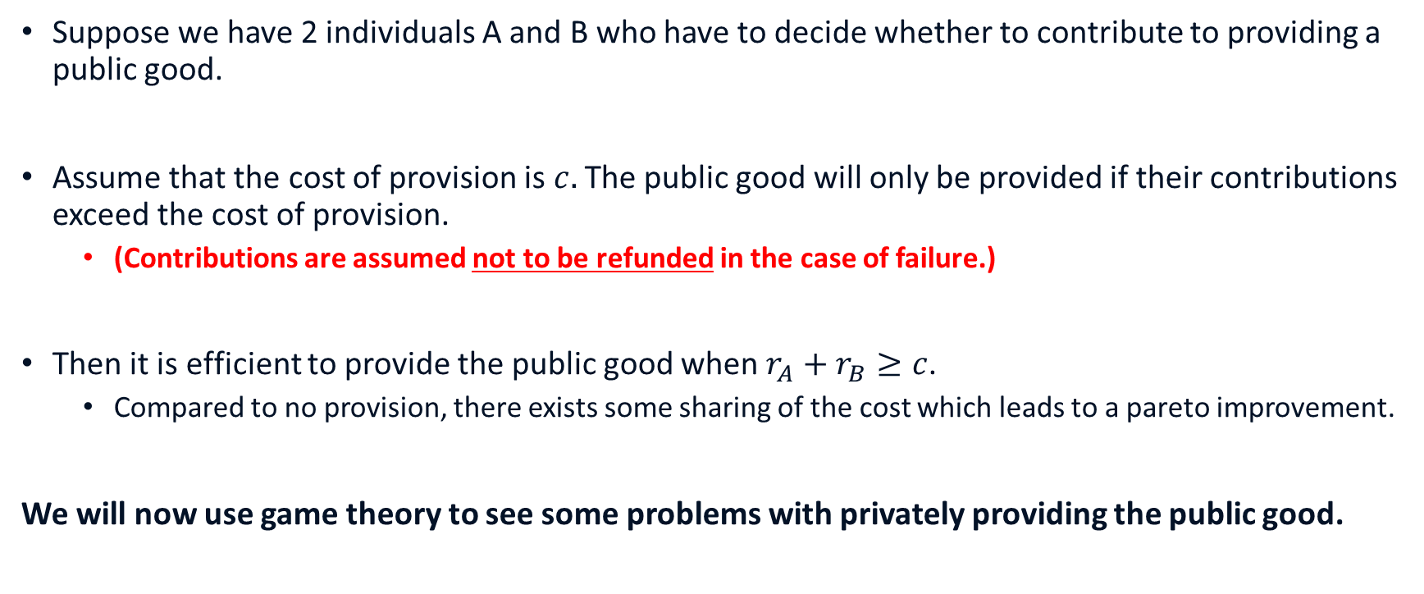
Public Goods
Suppose we have 2 individuals A and B who have to decide whether to contribute to providing a public good.
Assume that the cost of provision is $c.$ The public good will only be provided if their contributions exceed the cost of provision.
(Contributions are assumed not to be refunded in the case of failure.)
Then it is efficient to provide the public good when $r_{A}+r_{B}≥c$.
Compared to no provision, there exists some sharing of the cost which leads to a pareto improvement.
We will now use game theory to see some problems with privately providing the public good.

Slide 18
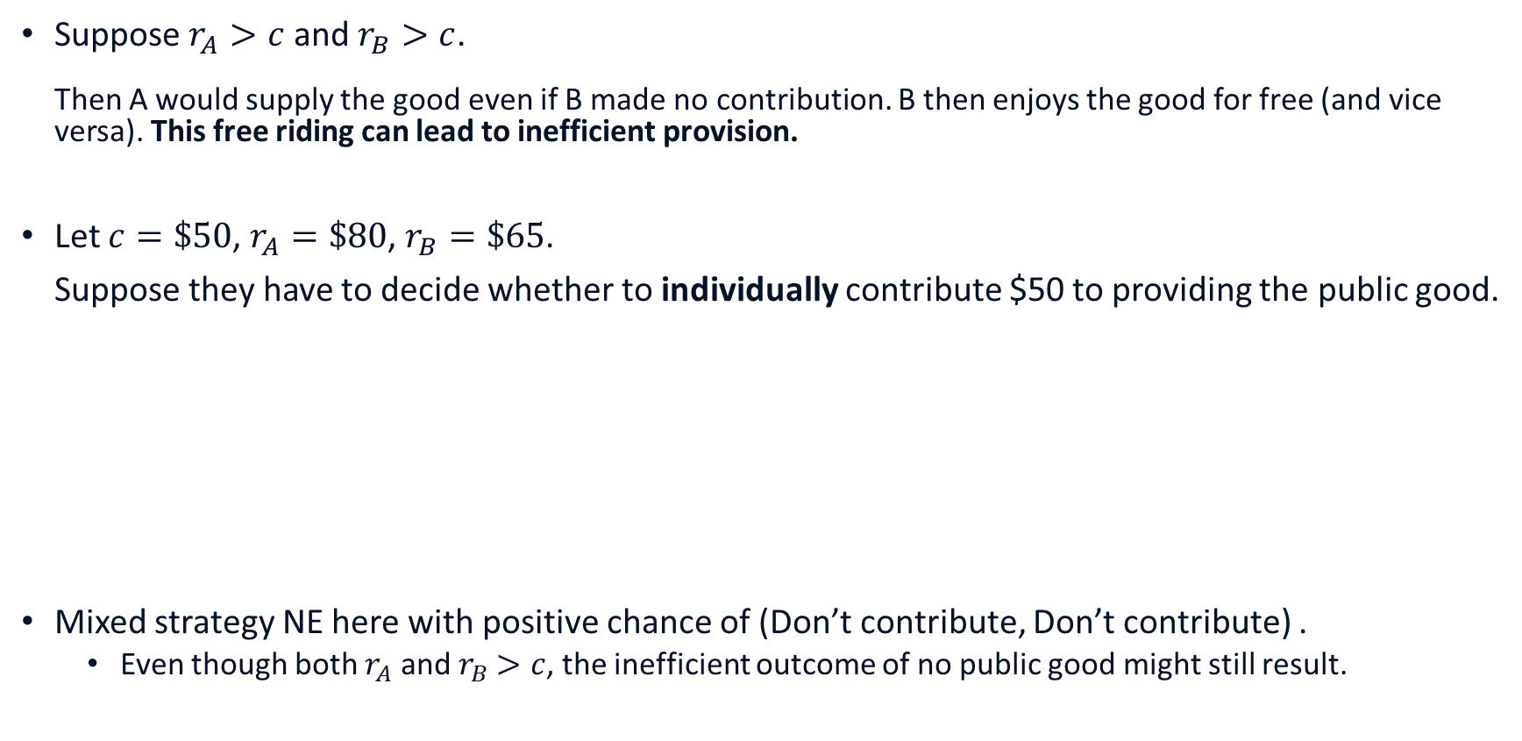
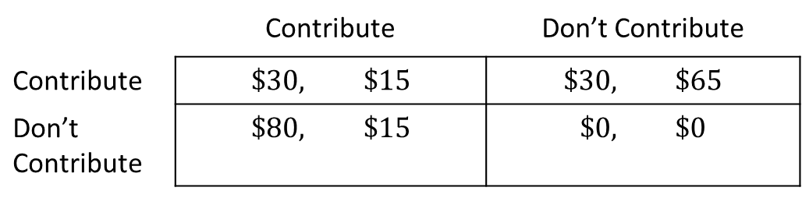
Scenario 1
Suppose $r_{A}>c$ and $r_{B}>c$. Then A would supply the good even if B made no contribution. B then enjoys the good for free (and vice versa). This free riding can lead to inefficient provision.
Let $c=\$50$, $r_{A}=\$80$, $r_{B}=\$65$.
Suppose they have to decide whether to individually contribute $50 to providing the public good.
Mixed strategy NE here with positive chance of (Don’t contribute, Don’t contribute) .
Even though both $r_{A}$ and $r_{B}$ $>c$, the inefficient outcome of no public good might still result.
Player B
 | Contribute | Don’t Contribute
Contribute | $$\$30, \$15$$ | $$\$30, \$65$$
Don’t Contribute | $$\$80, \$15$$ | $$\$0, \$0$$
Player A

Slide 19
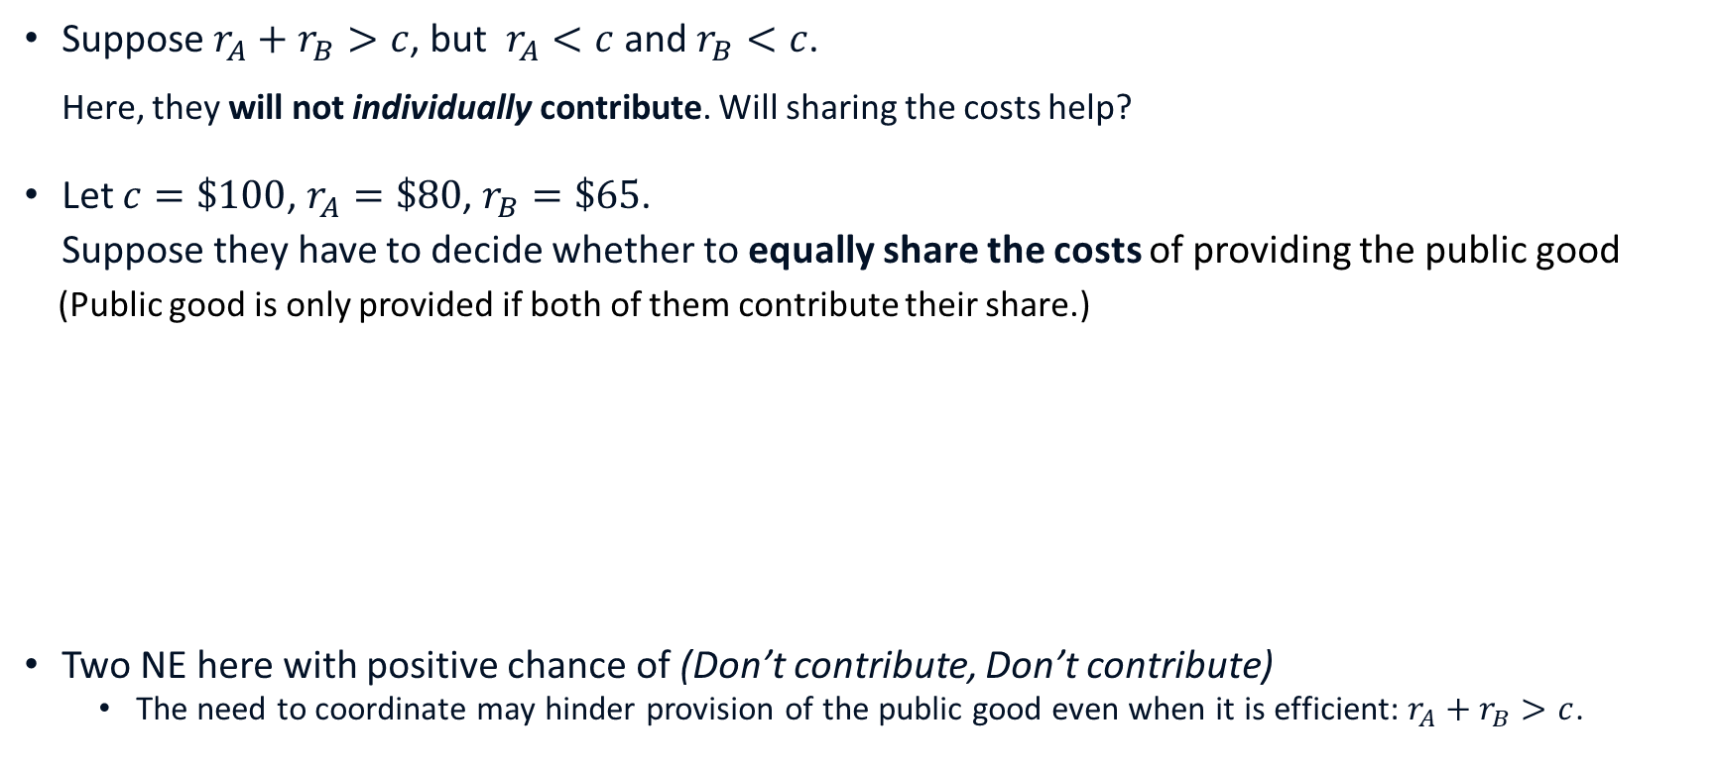
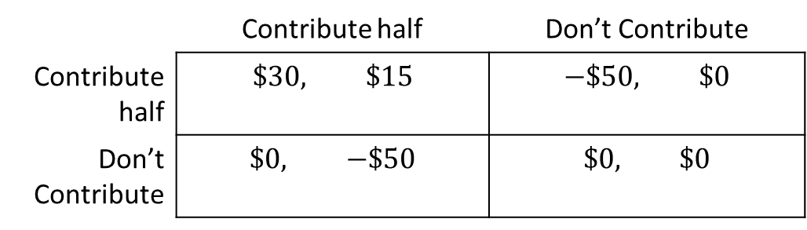
Scenario 2
Suppose $r_{A}+r_{B}>c$, but $r_{A}<c$ and $r_{B}<c$. Here, they will not individually contribute. Will sharing the costs help?
Let $c=\$100$, $r_{A}=\$80$, $r_{B}=\$65$.
Suppose they have to decide whether to equally share the costs of providing the public good
(Public good is only provided if both of them contribute their share.)
Two NE here with positive chance of (Don’t contribute, Don’t contribute)
The need to coordinate may hinder provision of the public good even when it is efficient: $r_{A}+r_{B}>c$.
Player B
 | Contribute half | Don’t Contribute
Contribute half | $$\$30, \$15$$ | $$−\$50, \$0$$
Don’t Contribute | $$\$0, −\$50$$ | $$\$0, \$0$$
Player A

Slide 20
An extended model of Public Goods

Slide 21
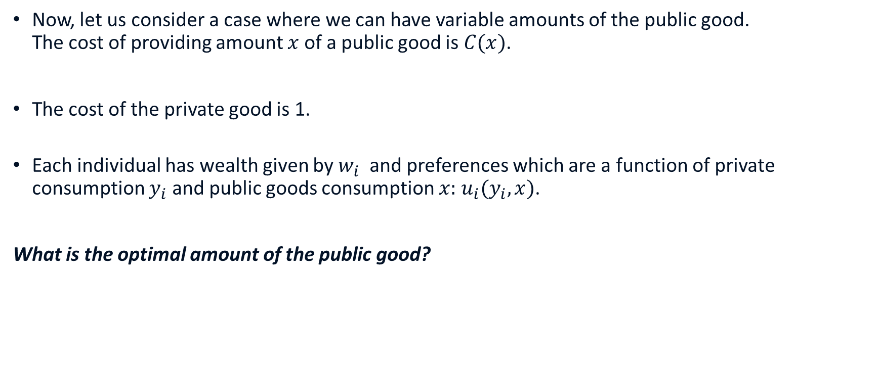
Variable Public Good Quantities
Now, let us consider a case where we can have variable amounts of the public good. The cost of providing amount $x$ of a public good is $C(x)$.
The cost of the private good is 1.
Each individual has wealth given by $w_{i}$ and preferences which are a function of private consumption $y_{i}$ and public goods consumption $x:$ $u_{i}(y_{i},x)$.
What is the optimal amount of the public good?

Slide 22

Social Optimal Outcome
Any (pareto) efficient allocation can be shown to satisfy the following condition:
$$∑\left|MRS_{i}\right|=C′(x)$$
Where $MRS_{i}=−MU_{x}/MU_{y_{i}}$ is the marginal rate of substitution between the private and public good for $i$.
$\left|MRS_{i}\right|$ tells us how much one marginal unit of the public good $x$ is worth in terms of the private good $y.$
Since the price of the private good is 1, $∑\left|MRS_{i}\right|$can be interpreted as the total private spending (across individuals) which gives the same utility as one marginal unit of the public good $x$.

Slide 23
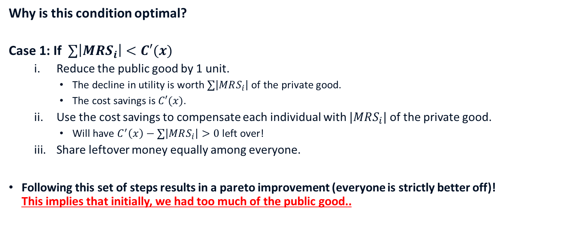
Social Optimal Outcome
Why is this condition optimal?
Case 1: If $∑\left|MRS_{i}\right|<C′(x)$
Reduce the public good by 1 unit.
The decline in utility is worth $∑\left|MRS_{i}\right|$ of the private good.
The cost savings is $C′(x)$.
Use the cost savings to compensate each individual with $|MRS_{i}|$ of the private good.
Will have $C^{′}\left(x\right)−∑\left|MRS_{i}\right|>0$ left over!
Share leftover money equally among everyone.
Following this set of steps results in a pareto improvement (everyone is strictly better off)! This implies that initially, we had too much of the public good..

Slide 24
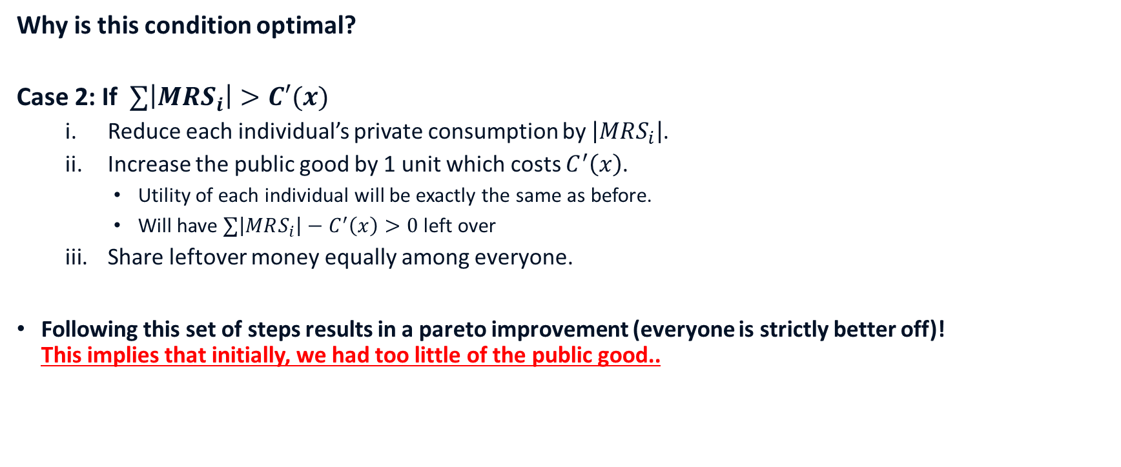
Social Optimal Outcome
Why is this condition optimal?
Case 2: If $∑\left|MRS_{i}\right|>C′(x)$
Reduce each individual’s private consumption by $\left|MRS_{i}\right|$.
Increase the public good by 1 unit which costs $C^{′}\left(x\right)$.
Utility of each individual will be exactly the same as before.
Will have $∑\left|MRS_{i}\right|−C^{′}\left(x\right)>0$ left over
Share leftover money equally among everyone.
Following this set of steps results in a pareto improvement (everyone is strictly better off)! This implies that initially, we had too little of the public good..

Slide 25
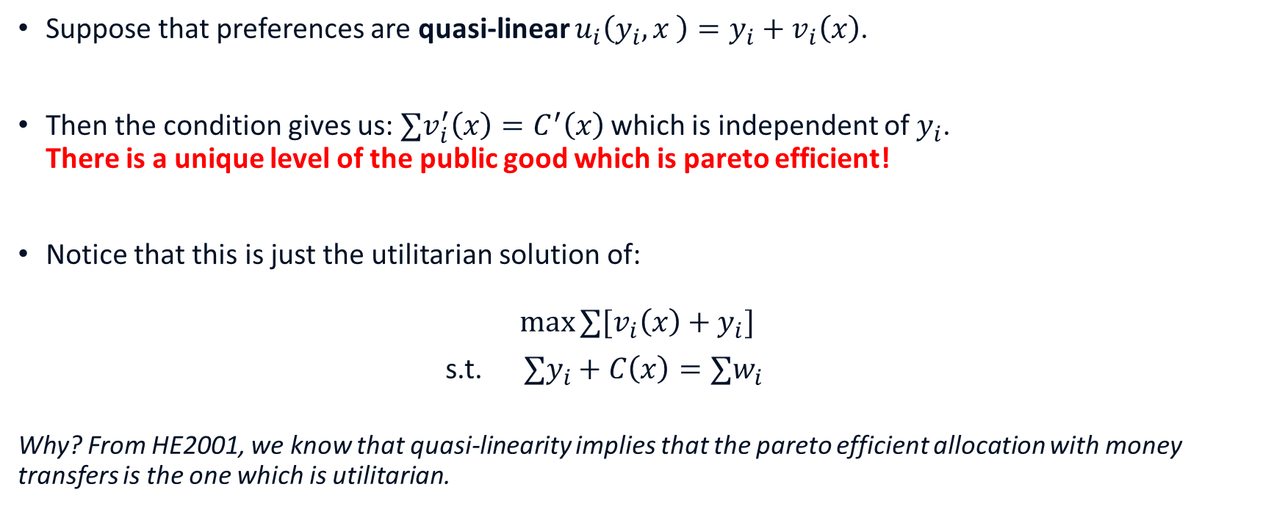
Social Optimal Outcome (Quasi-linear)
Suppose that preferences are quasi-linear $u_{i}\left(y_{i},x \right)=y_{i}+v_{i}\left(x\right)$.
Then the condition gives us: $∑v_{i}^{′}\left(x\right)=C^{′}\left(x\right)$ which is independent of $y_{i}$. There is a unique level of the public good which is pareto efficient!
Notice that this is just the utilitarian solution of:
$$\max{∑{[v}_{i}\left(x\right)+y_{i}] }$$
s.t. $∑y_{i}+C\left(x\right)=∑w_{i}$
Why? From HE2001, we know that quasi-linearity implies that the pareto efficient allocation with money transfers is the one which is utilitarian.
Notes:
Just substitute the constraint into the maximising function

Slide 26
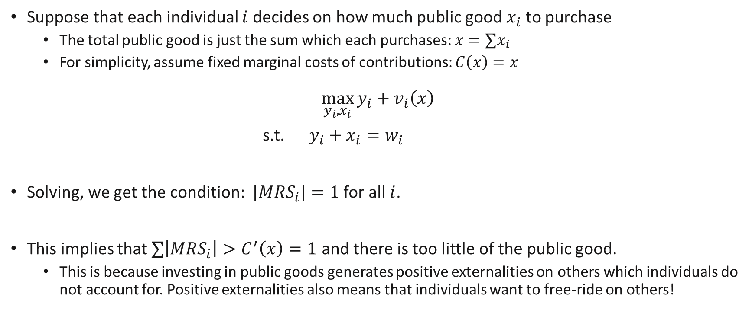
What is the free market outcome?
Suppose that each individual $i$ decides on how much public good $x_{i}$ to purchase
The total public good is just the sum which each purchases: $x=∑x_{i}$
For simplicity, assume fixed marginal costs of contributions: $C\left(x\right)=x$
$$\max_{y_{i},x_{i}}{y_{i}+v_{i}\left(x\right)}$$
s.t. $y_{i}+x_{i}=w_{i}$
Solving, we get the condition: $|MRS_{i}|=1$ for all $i$.
This implies that $∑\left|MRS_{i}\right|>C^{′}\left(x\right)=1$ and there is too little of the public good.
This is because investing in public goods generates positive externalities on others which individuals do not account for. Positive externalities also means that individuals want to free-ride on others!
From MRS = price ratio for each individual

Slide 27
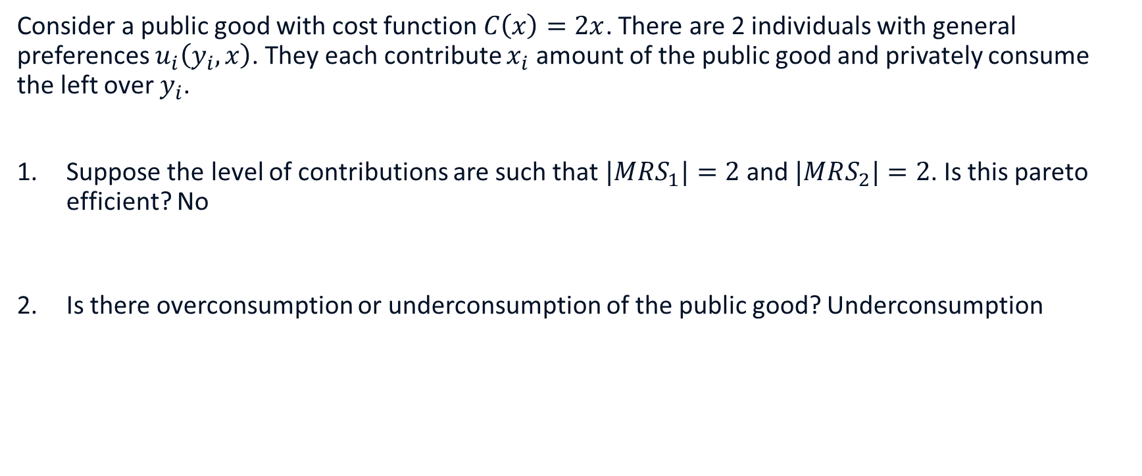
Review Questions 2
Consider a public good with cost function $C\left(x\right)=2x$. There are 2 individuals with general preferences $u_{i}\left(y_{i},x\right)$. They each contribute $x_{i}$ amount of the public good and privately consume the left over $y_{i}$.
Suppose the level of contributions are such that $|MRS_{1}|=2$ and $|MRS_{2}|=2$. Is this pareto efficient? No
Is there overconsumption or underconsumption of the public good? Underconsumption

Slide 28
Mechanisms for Public Goods Provision

Slide 29
Alternative Mechanisms
As long as public goods remain non-excludable, with externalities and free riding incentives, private market mechanisms are often inefficient.
Hence public goods provision tends to rely on more centralised mechanisms.
Voting is one example, but has its weaknesses (see HE2001 notes, textbook).
Alternatively, perhaps we can design a specific procedure which determines whether to provide a public good and how much each person should pay?
How may such a mechanism decide on how much/whether to supply a public good?

Slide 30

Demand Revelation
The previous analysis implies that we need to know their valuations $|MRS_{i}|$ to efficiently supply a public good!
If we naively ask, people might have incentives to inflate their valuations to get more of it. Need proper incentives!
A scheme that makes it rational for individuals to reveal truthfully their private valuations of a public good is a revelation mechanism.
An example of this is the Vickrey-Clarke-Groves (VCG) taxation scheme. We will now study how it works.

Slide 31
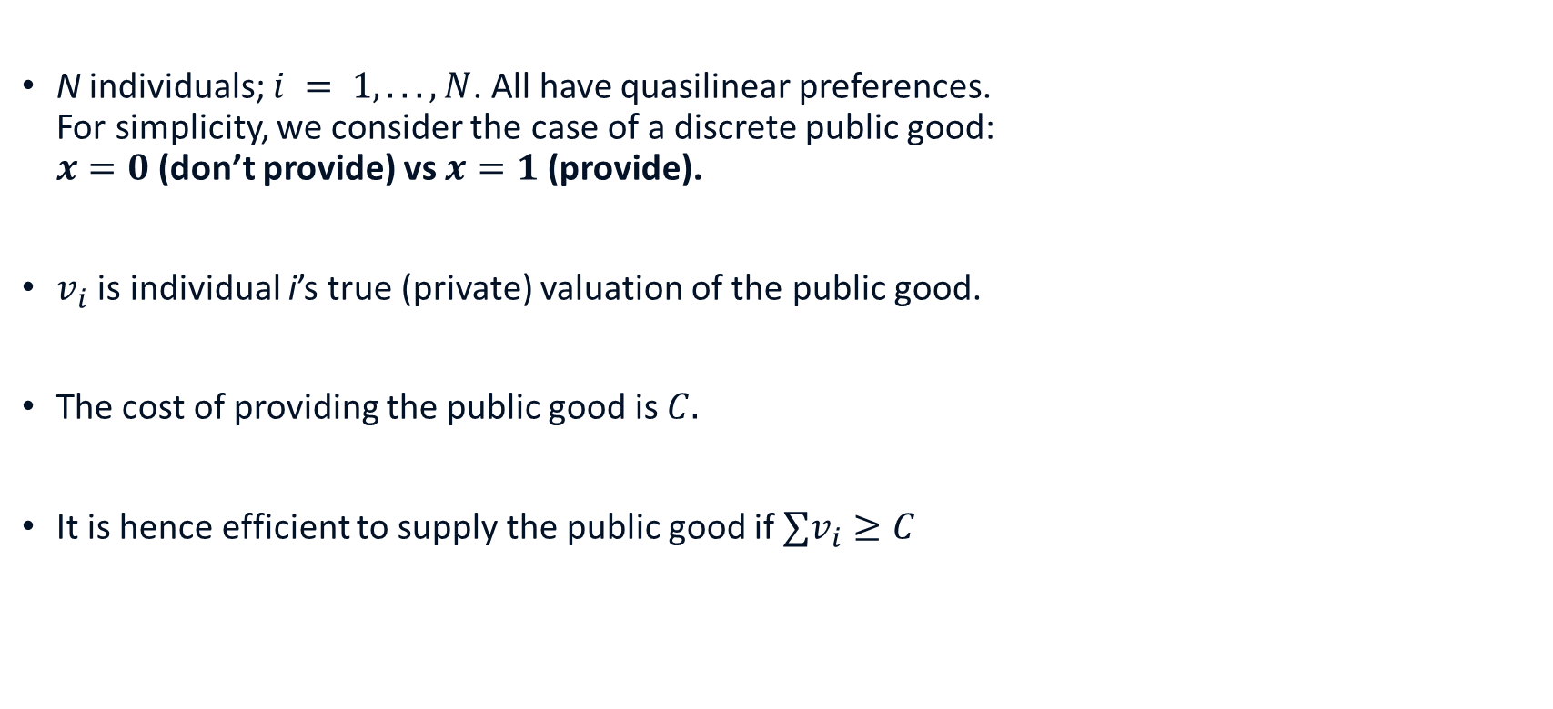
The Setup
N individuals; $i = 1, . . . , N$. All have quasilinear preferences. For simplicity, we consider the case of a discrete public good: $x=0$ (don’t provide) vs $x=1$ (provide).
$v_{i}$ is individual i’s true (private) valuation of the public good.
The cost of providing the public good is $C.$
It is hence efficient to supply the public good if$∑v_{i}≥C$

Slide 32
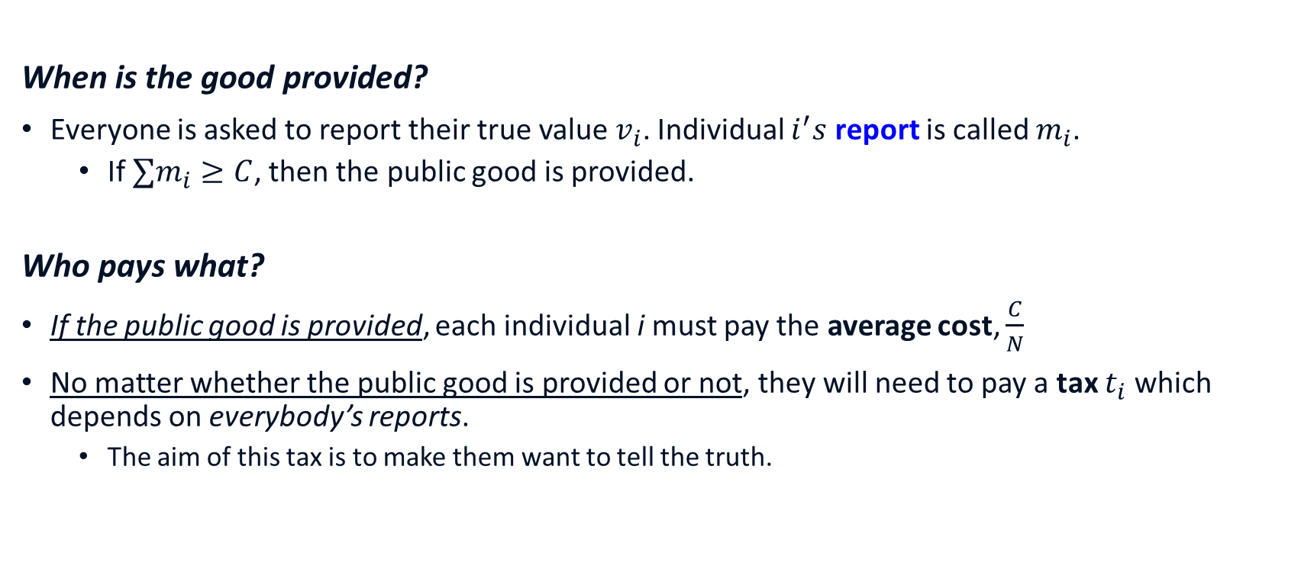
The VCG mechanism
When is the good provided?
Everyone is asked to report their true value $v_{i}$. Individual $i^{′}s$ report is called $m_{i}$.
If $∑m_{i}≥C$, then the public good is provided.
Who pays what?
If the public good is provided, each individual i must pay the average cost, $\frac{C}{N}$
No matter whether the public good is provided or not, they will need to pay a tax $t_{i}$ which depends on everybody’s reports.
The aim of this tax is to make them want to tell the truth.

Slide 33

The VCG mechanism: Pivotality
We call an individual $i$ pivotal if
$\sum_{j≠i}{\left(m_{j}−\frac{C}{N}\right)}<0$ and $\sum_{j}{\left(m_{j}−\frac{C}{N}\right)}≥0$ or
$\sum_{j≠i}{\left(m_{j}−\frac{C}{N}\right)}≥0 \text{and} \sum_{j}{\left(m_{j}−\frac{C}{N}\right)}<0$
I.e. with his inclusion, the supply decision changes from what the others would want to do (on average) based on their reports.
Why the focus on pivotality?
Losses are only inflicted on others when an individual is pivotal.

Slide 34
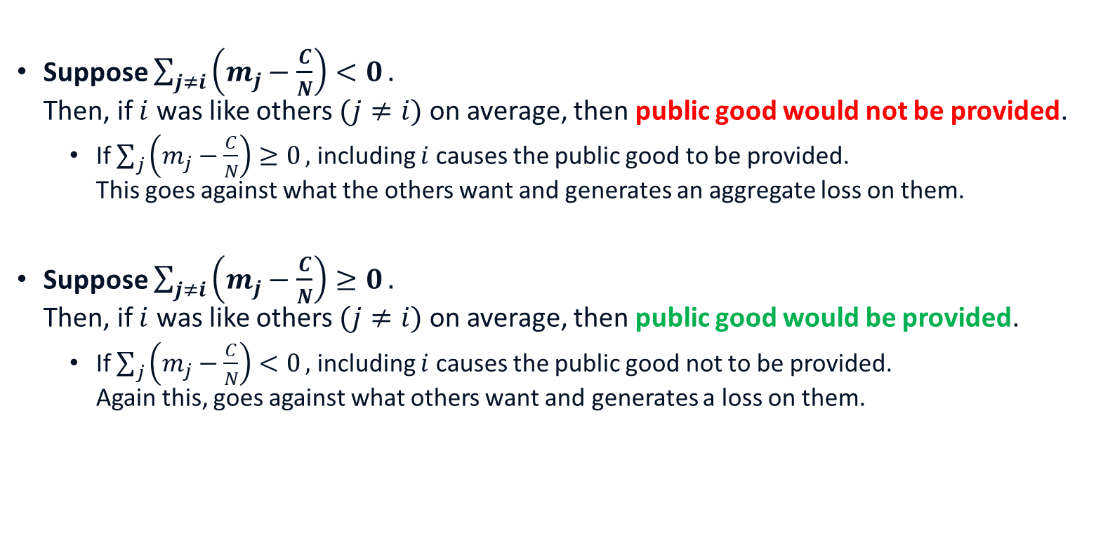
The VCG mechanism: Pivotality
Suppose $\sum_{j≠i}{\left(m_{j}−\frac{C}{N}\right)<0}.$ Then, if $i$ was like others $(j≠i)$ on average, then public good would not be provided.
If $\sum_{j}{\left(m_{j}−\frac{C}{N}\right)≥0},$ including $i$ causes the public good to be provided. This goes against what the others want and generates an aggregate loss on them.
Suppose $\sum_{j≠i}{\left(m_{j}−\frac{C}{N}\right)≥0}.$ Then, if $i$ was like others $(j≠i)$ on average, then public good would be provided.
If $\sum_{j}{\left(m_{j}−\frac{C}{N}\right)<0},$ including $i$ causes the public good not to be provided. Again this, goes against what others want and generates a loss on them.

Slide 35
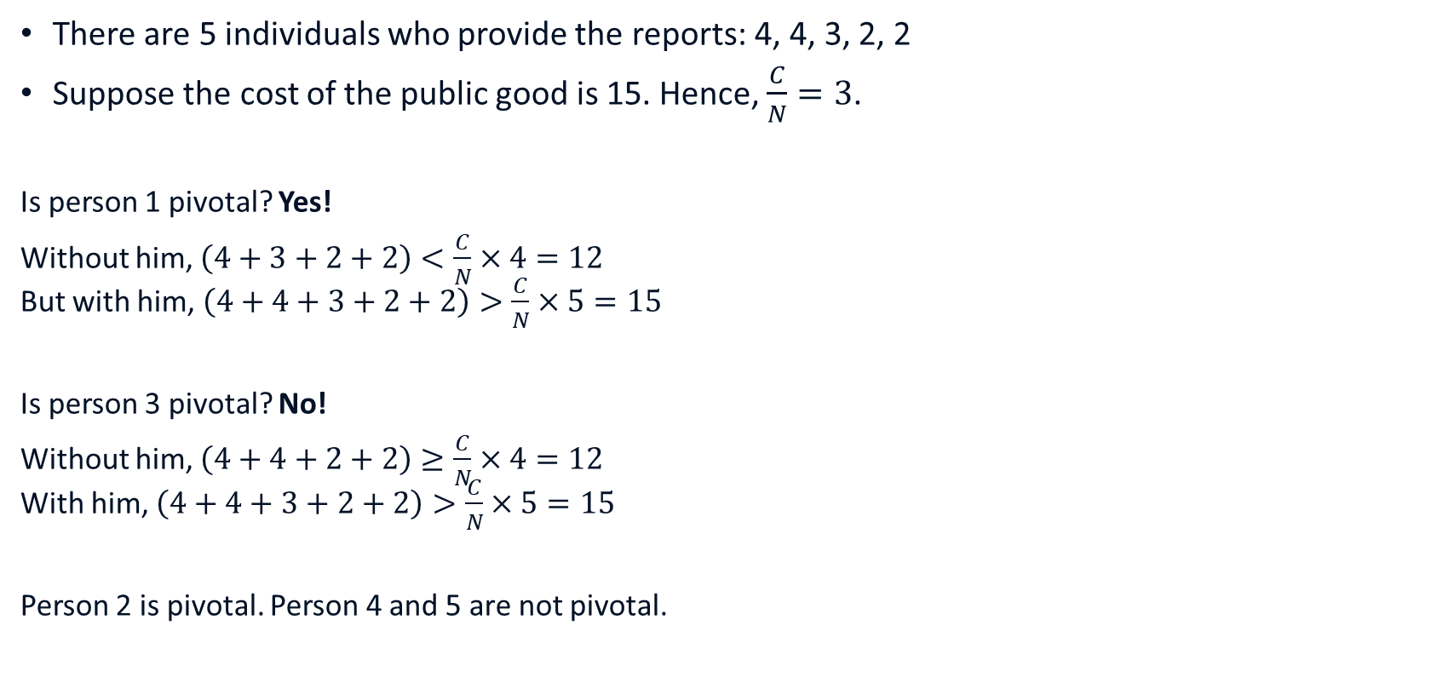
Example of pivotality
There are 5 individuals who provide the reports: 4, 4, 3, 2, 2
Suppose the cost of the public good is 15. Hence, $\frac{C}{N}=3$.
Is person 1 pivotal? Yes!
Without him, $\left(4+3+2+2\right)<\frac{C}{N}×4=12$ But with him, $\left(4+4+3+2+2\right)>\frac{C}{N}×5=15$
Is person 3 pivotal? No!
Without him, $\left(4+4+2+2\right)≥\frac{C}{N}×4=12$ With him, $\left(4+4+3+2+2\right)>\frac{C}{N}×5=15$
Person 2 is pivotal. Person 4 and 5 are not pivotal.

Slide 36
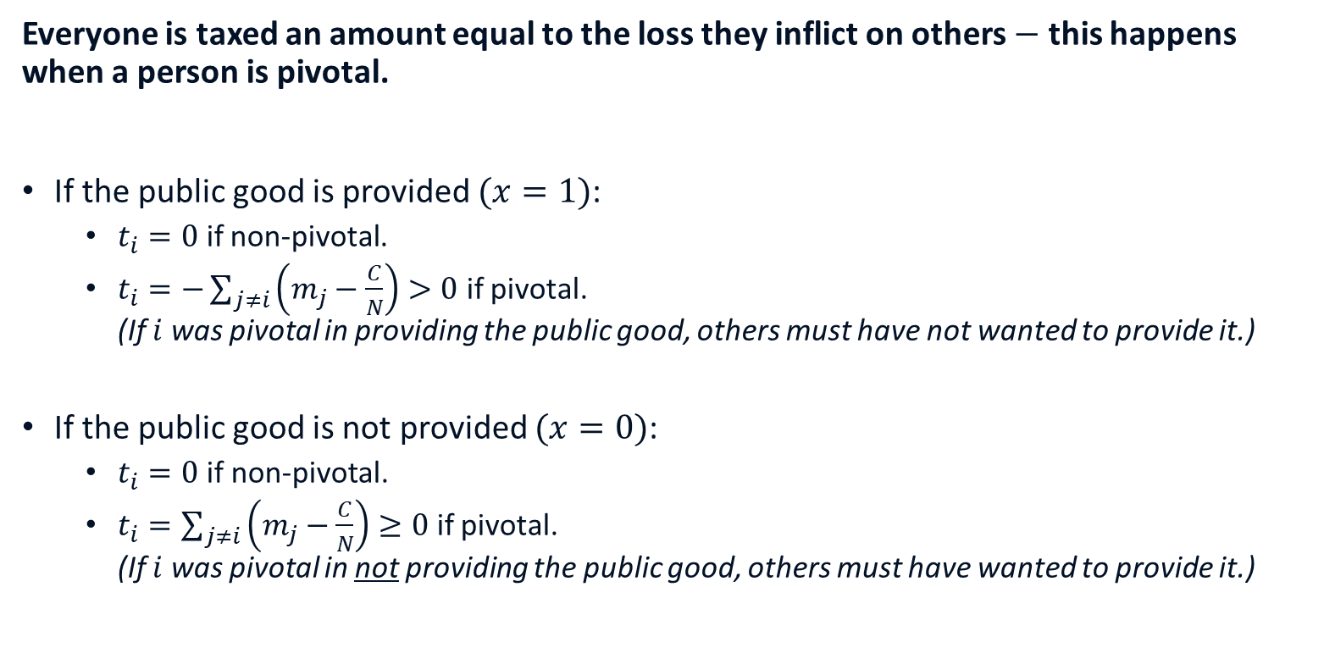
The VCG mechanism: Taxes
Everyone is taxed an amount equal to the loss they inflict on others $−$ this happens when a person is pivotal.
If the public good is provided $(x=1)$:
$t_{i}=0$ if non-pivotal.
$t_{i}=−\sum_{j≠i}{\left(m_{j}−\frac{C}{N}\right)}>0$ if pivotal. (If $i$ was pivotal in providing the public good, others must have not wanted to provide it.)
If the public good is not provided $(x=0)$:
$t_{i}=0$if non-pivotal.
$t_{i}=\sum_{j≠i}{\left(m_{j}−\frac{C}{N}\right)}≥0$ if pivotal. (If $i$ was pivotal in not providing the public good, others must have wanted to provide it.)

Slide 37

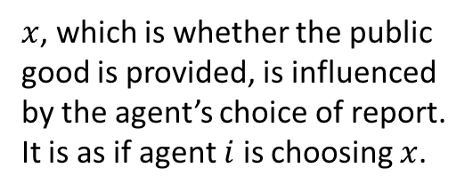
The VCG mechanism: Payoffs
Suppose other agents favour the public good: $\sum_{j≠i}{\left(m_{j}−\frac{C}{N}\right)}≥0$
Then agent $i^{′}s$ payoff is
$$\left(v_{i}−\frac{C}{N}\right)x−\left(1−x\right)\sum_{j≠i}{\left(m_{j}−\frac{C}{N}\right)}$$ $$=x(v_{i}+\sum_{j≠i}{m_{j}−C)−}\sum_{j≠i}{\left(m_{j}−\frac{C}{N}\right)}$$
Loss in utility from tax if good is not provided $(x=0)$
$x$, which is whether the public good is provided, is influenced by the agent’s choice of report. It is as if agent $i$ is choosing $x$.

Slide 38


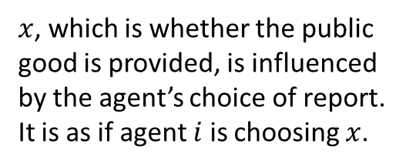
The VCG mechanism: Payoffs
Suppose other agents do not favour the public good: $\sum_{j≠i}{\left(m_{j}−\frac{C}{N}\right)}<0$
Then agent $i^{′}$s payoff is:
$$x\left(v_{i}−\frac{C}{N}\right)+x\sum_{j≠i}{\left(m_{j}−\frac{C}{N}\right)}$$ $$=x(v_{i}+\sum_{j≠i}{m_{j}−C)}$$
Loss in utility from tax if good is provided $(x=1)$
$x$, which is whether the public good is provided, is influenced by the agent’s choice of report. It is as if agent $i$ is choosing $x$.

Slide 39
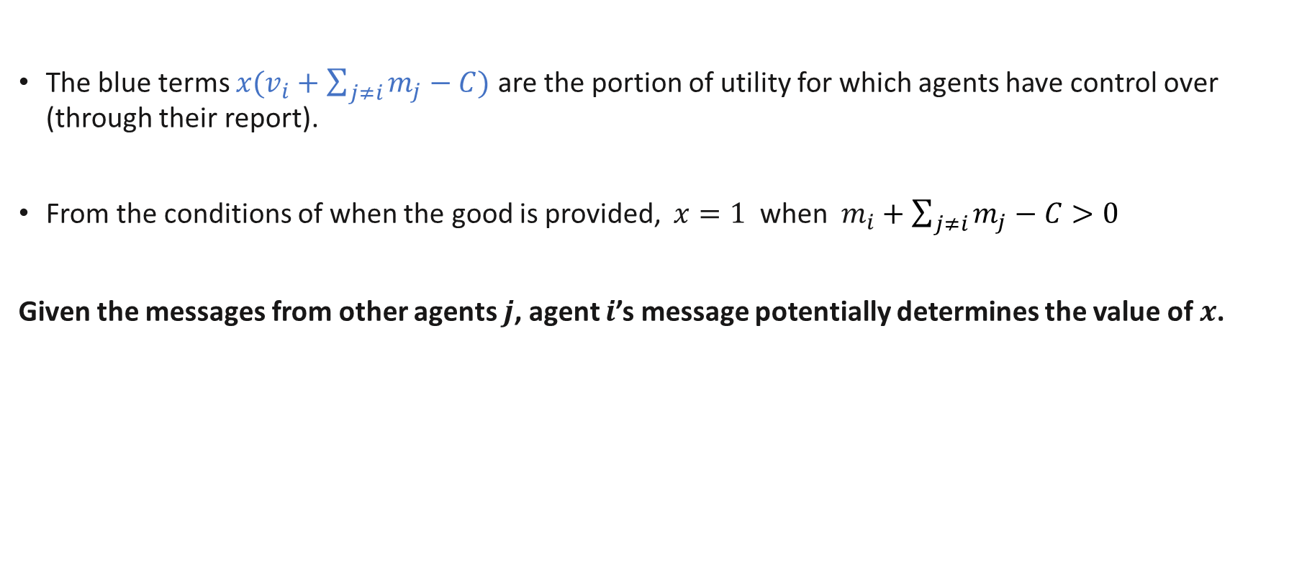
The VCG mechanism
The blue terms $x(v_{i}+\sum_{j≠i}{m_{j}−C)}$ are the portion of utility for which agents have control over (through their report).
From the conditions of when the good is provided, $x=1$ when $m_{i}+$ $\sum_{j≠i}{m_{j}−C>0}$
Given the messages from other agents $j$, agent $i$’s message potentially determines the value of $x$.

Slide 40
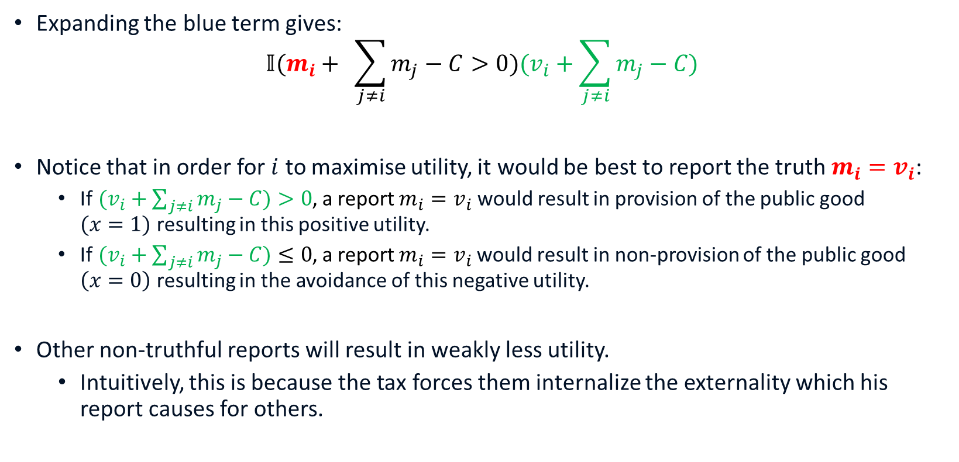

The VCG mechanism
Expanding the blue term gives:
$$𝕀(m_{i}+ \sum_{j≠i}{m_{j}−C>0})(v_{i}+\sum_{j≠i}{m_{j}−C)}$$
Notice that in order for $i$ to maximise utility, it would be best to report the truth $m_{i}=v_{i}$:
If$(v_{i}+\sum_{j≠i}{m_{j}−C)>0}$, a report $m_{i}=v_{i}$ would result in provision of the public good $(x=1)$ resulting in this positive utility.
If$(v_{i}+\sum_{j≠i}{m_{j}−C)}≤0$, a report $m_{i}=v_{i}$would result in non-provision of the public good $\left(x=0\right)$ resulting in the avoidance of this negative utility.
Other non-truthful reports will result in weakly less utility.
Intuitively, this is because the tax forces them internalize the externality which his report causes for others.
$$x$$
Notes:
$𝕀$ is the indicator function
In the first case, if report too low, then might lose the public good.
In the second case, if report too high then might get a loss.
Same as reasoning for second price auction.

Slide 41
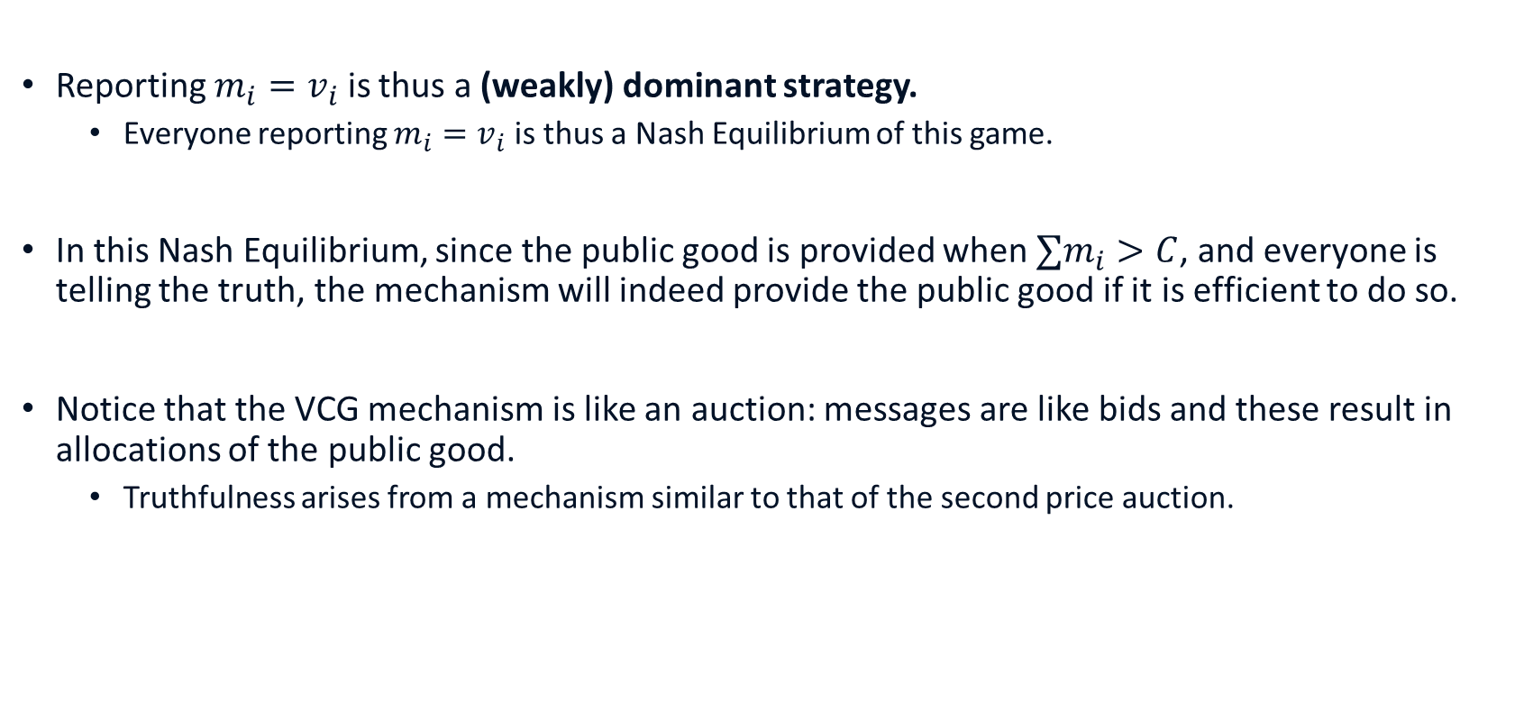
The VCG mechanism
Reporting $m_{i}=v_{i}$ is thus a (weakly) dominant strategy.
Everyone reporting $m_{i}=v_{i}$ is thus a Nash Equilibrium of this game.
In this Nash Equilibrium, since the public good is provided when $∑m_{i}>C$, and everyone is telling the truth, the mechanism will indeed provide the public good if it is efficient to do so.
Notice that the VCG mechanism is like an auction: messages are like bids and these result in allocations of the public good.
Truthfulness arises from a mechanism similar to that of the second price auction.

Slide 42
Remarks
The VCG implicitly requires quasi linear preferences as we can’t have payments influencing demand for the public good.
While it guarantees the efficient provision of the public good, there is still resource inefficiency due to taxes removing wealth from pivotal individuals
These taxes cannot be fed back into the system so as to maintain incentive compatibility.
There is thus a drop in private consumption.
This result is more general: there are no processes which are simultaneously dominant strategy incentive compatible and have no resource inefficiency over a reasonable range of possible environments. (even under quasi-linear utility.)
See the textbook for more discussions of weaknesses: collusion and equity.

Slide 43
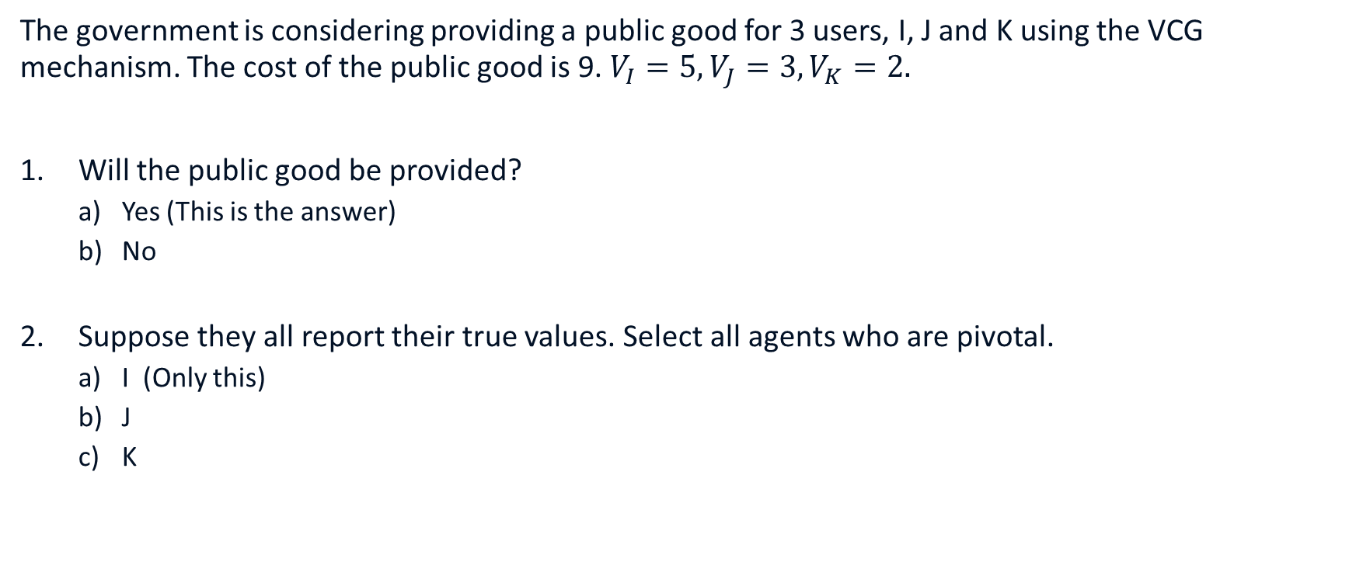
Review Questions 3
The government is considering providing a public good for 3 users, I, J and K using the VCG mechanism. The cost of the public good is 9. $V_{I}=5, V_{J}=3, V_{K}=2.$
Will the public good be provided?
Yes (This is the answer)
No
Suppose they all report their true values. Select all agents who are pivotal.
I (Only this)
J
K
Notes:
Hint: compare$\sum_{j≠i}{\left(m_{j}−\frac{C}{N}\right)}$ with $\sum_{j}{\left(m_{j}−\frac{C}{N}\right)}$for each individual $i$.

Slide 44
Key learning outcomes
Properties of different kinds of goods.
How does the tragedy of commons lead to inefficiency and potential solutions.
Why is there (potential) inefficiency for public goods?
How to use the VCG mechanism to implement the efficient outcome for public goods?

Slide 45
References
Varian Chapter 35
Varian Chapter 37
Related articles: changing the structure of public goods
Digital media and the public goods problem
The lighthouse myth

